Slide 1

SRI CHANDRASEKHARENDRA SARASWATHI VISWA MAHA VIDHYALAYA
(Deemed to be university u/s 3 of UGC act 1956) (Accredited with “A” by NAAC) Enathur, Kanchipuram – 631561. Tamilnadu www.kanchiuniv.ac.in
DEPARTMENT OF COMPUTER SCIENCE AND ENGINEERING
BCSF186Z90-CIP Project Work
AuraMed AI: SmartCare - Intelligent Patient Interaction System for Enhanced Healthcare Services
11239A040, Kadapanatham Srinidhi Kasyap
11239A064,Oruganti Abhinav
Guided By
Dr.r.prema,
assistant professor
University Review: 29-04-2026

Slide 2
AuraMed AI: SmartCare - Intelligent Patient Interaction System for Enhanced Healthcare Services
Abstract :
A symptom-based medical chatbot that interacts with users to collect health-related inputs.
Analyzes symptoms using predefined rules and basic machine learning techniques.
Provides possible condition suggestions along with precautionary advice.
Offers a simple and interactive interface for quick and easy usage.
Aims to support early awareness and initial self-assessment.
Designed for scalability with future integration of NLP and larger datasets.
Acts as a supportive tool and encourages professional medical consultation when needed.
Keywords:
Artificial Intelligence
Chatbot
Healthcare
Machine Learning
Symptom Analysis
User Interface

Slide 3
AuraMed Al: SmartCare - Intelligent Patient Interaction System for Enhanced Healthcare Services
Problem Statement:
Many people lack immediate access to basic medical guidance for common symptoms.
Minor health issues often lead to unnecessary hospital visits, increasing system load.
Delays in identifying symptoms can worsen conditions due to lack of early awareness.
Existing online resources are either too generic or difficult for non-medical users to interpret.
There is a need for a simple, interactive system that can guide users based on symptoms.
The solution should provide quick, preliminary suggestions without replacing professional diagnosis.
The challenge is to ensure reliability, clarity, and ease of use while handling user inputs.

Slide 4
AuraMed Al: SmartCare - Intelligent Patient Interaction System for Enhanced Healthcare Services
Literature survey:
Author / Year | Methods Used | Key Idea | Limitation
Ashwin A.S (2025) | ML + NLP (T5 + Random Forest) | Combines text + voice chatbot for symptom-based prediction | Needs high-quality dataset for accuracy
Evani V.S.S. Lalitha (2025) | NLP Chatbot | Focus on improving healthcare accessibility using AI chatbot | Limited real-world validation
Ananditha Raghunath (2026) | AI Chatbot (User Study) | Studies how Indian users interact and trust chatbot advice | Users often reject or doubt chatbot outputs
Pragnya Ramjee (2024) | LLM-based Chatbot (ASHABot) | Supports community health workers with medical info | Requires human expert support for accuracy
Alison Darcy (2023) | AI Therapy Chatbot | Uses chatbot for mental health support (Woebot) | Limited to specific domains, not full diagnosis

Slide 5
AuraMed Al: SmartCare - Intelligent Patient Interaction System for Enhanced Healthcare Services
Existing system & its Drawbacks
Traditional symptom checkers and medical websites provide general health information but require manual search.
Rule-based chatbots rely on fixed symptom–disease mappings, inflexible for varied cases.
Advanced systems using machine learning or NLP offer better predictions but are complex and resource-intensive.
Most existing solutions struggle to handle multiple or overlapping symptoms effectively.
Lack of personalization based on individual user history and conditions.
Dependence on large datasets affects performance and accuracy.
No system guarantees medical reliability, often lacking real-time validation.

Slide 6
AuraMed AI: SmartCare - Intelligent Patient Interaction System for Enhanced Healthcare Services
Proposed Method
Rule-based chatbot for symptom analysis and basic health guidance
Maps user inputs to possible conditions using predefined logic
Modules
UI – Input collection
Processing – Data structuring
Decision Engine – Rule mapping
Knowledge Base – Data storage
Response – Output generation
Architecture
User → Processing → Decision Engine → Knowledge Base → Response

Slide 7
AuraMed AI: SmartCare - Intelligent Patient Interaction System for Enhanced Healthcare Services
Plan
Requirement Analysis: Define scope, objectives, and user needs
Dataset & Rule Definition: Prepare medical data and decision logic
System Design: Plan architecture, modules, and data flow
Development & Integration: Build and connect all components
Testing & Optimization: Validate performance and refine system .
Methodology
Symptom Input: User provides symptoms through the interface
Data Preprocessing: Input is cleaned, structured, and validated
Analysis Engine: Rule-based logic is applied to interpret symptoms
Database Matching: Processed data is compared with the medical dataset
Response Generation: System generates condition insights and suggestions
Feedback Loop: User responses are used to refine and improve accuracy

Slide 8
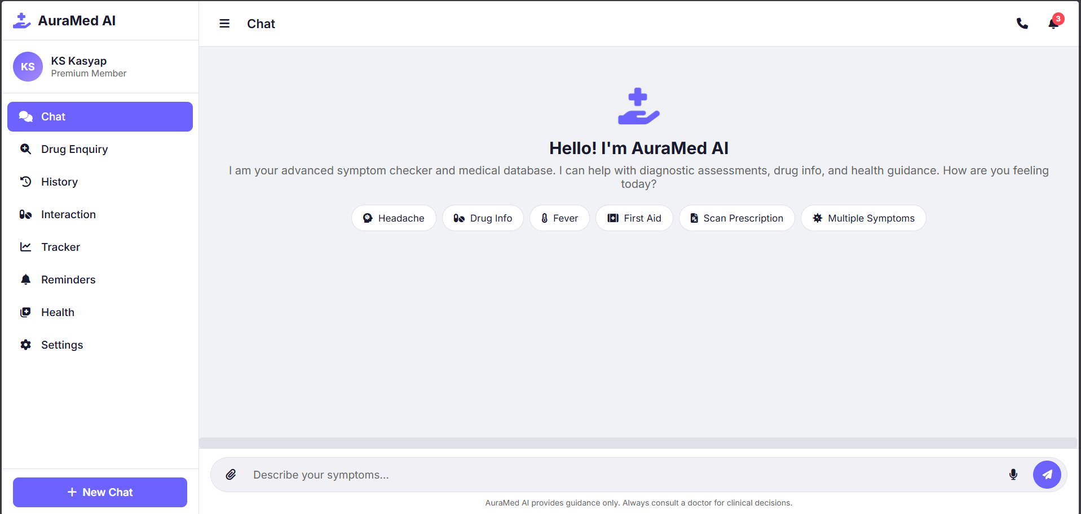
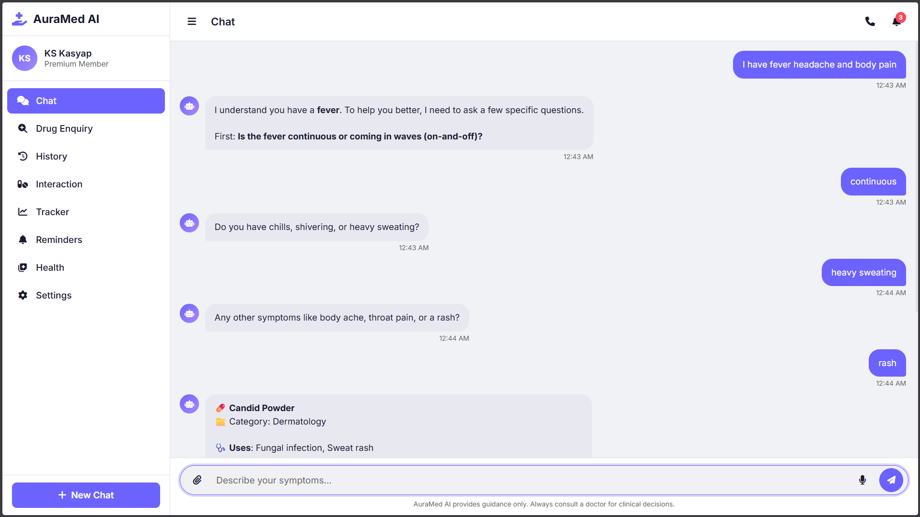
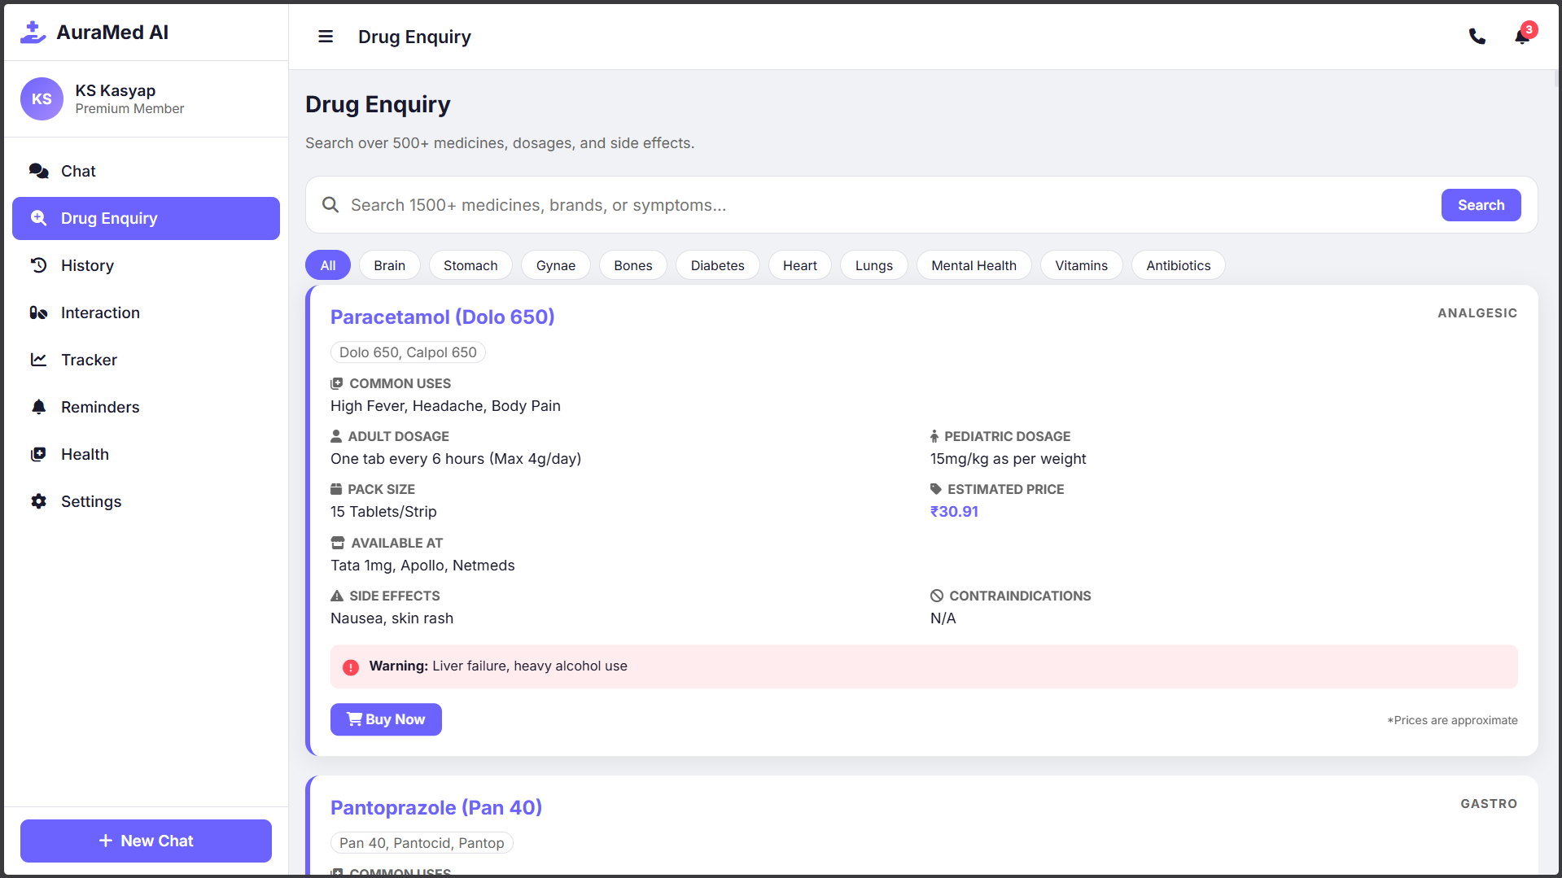
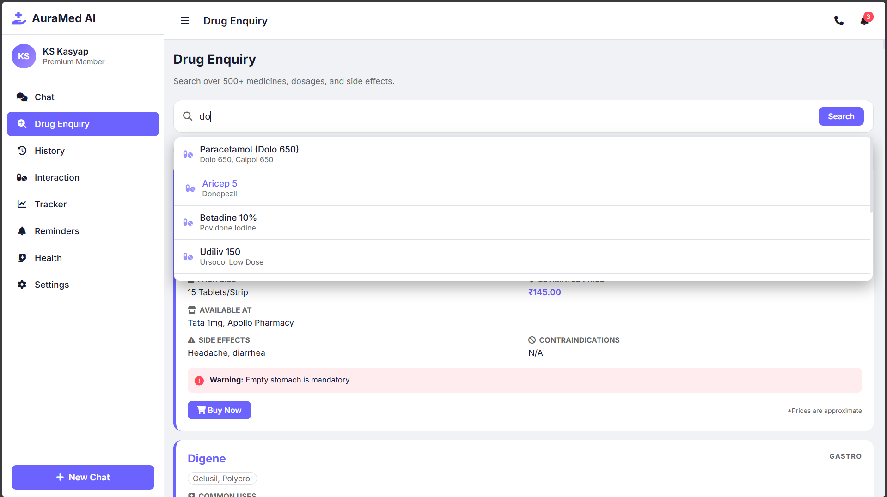
Result & Analysis

Slide 9
Conclusion:
The project presents a structured, symptom-based chatbot for preliminary health guidance.
It captures user inputs and provides condition suggestions using rule-based decision logic.
The system emphasizes simplicity, interpretability, and ease of use over complex models.
It improves access to basic health information and supports early self-assessment.
The solution is limited to guidance and does not perform clinical diagnosis or prescription.
The work provides a scalable base for future integration of advanced AI techniques.

Slide 10
Future Enhancement
Smart Triage Implementation: Incorporation of severity and duration parameters to prioritize
symptoms and guide users more effectively.
Personalized Reminder System: Development of automated reminders for medications,
hydration, and follow-up actions.
Symptom Tracking Integration: Enabling continuous tracking of user symptoms with basic trend
analysis for better monitoring.
NLP-Based Interaction Enhancement: Improving chatbot capability to understand natural and
unstructured user inputs.
Knowledge Base Expansion: Extending and regularly updating the medical dataset to improve
coverage and relevance.
Telemedicine Integration: Providing direct linkage to doctor consultation for high-risk or unclear
cases.

Slide 11
References
Aggarwal, R., et al. (2023). Artificial Intelligence–Based Chatbots in Healthcare: A Systematic Review. Journal of Medical Internet Research.
Babu, A. V., et al. (2024). Symptom-Based Disease Prediction Using Machine Learning Techniques. Procedia Computer Science.
Ramjee, P., et al. (2024). ASHABot: A Large Language Model-Based Health Assistant for Community Workers. arXiv / IEEE Access.
Bai, X., et al. (2025). Evaluation of AI Chatbots for Medical Decision Support. Journal of Medical Internet Research.
Lalitha, E. V. S. S., et al. (2025). AI-Based Healthcare Chatbot for Symptom Analysis and User Interaction. International Journal of Innovative Research in Technology.

Slide 12
Thank you

